Slide 1
Digital Transformation through the Covid-19 Experience Ideas, thoughts, and early insights on a research on what digital transformation means in these times
Saverio Romeo
Associate Lecturer on Emerging Digital Technologies Management and Policy – Birkbeck, University of London

Slide 2
Agenda
Pre-Covid 19 Phase
The energy of the
digital transformation
paradigm
Covid 19 Lockdown Phase
The stress test for the digital
transformation paradigm
Covid 19 Phase 1 and beyond
Does the digital transformation
paradigm need to be re-thought?

Slide 3
What is digital transformation?
“Our framework foregrounds digital transformation as a process where digital technologies create disruptions triggering strategic responses from organizations that seek to alter their value creation paths while managing the structural changes and organizational barriers that affect the positive and negative outcomes of this process.” Vial, G. 2019. Understanding digital transformation: A review and a research agenda. The Journal of Strategic Information Systems, Volume 28, Issue 2.
Eight key words or dimensions: digital technologies, disruptions, strategic responses, value creation paths, structural changes, organisational barriers, positive and negative outcomes.

Slide 4
The IoT was set to grow in revenues
Pre-Covid 19 Phase
The energy of the
digital transformation
paradigm
Global IoT Market in $B
1,400
1,223
1,200
1,000
899
37%
800
661
600
486
400
30%
352
255
200
151
196
0
2018
2019
2020
2021
2022
2023
2024
2025
Xx% = CAGR

Slide 5
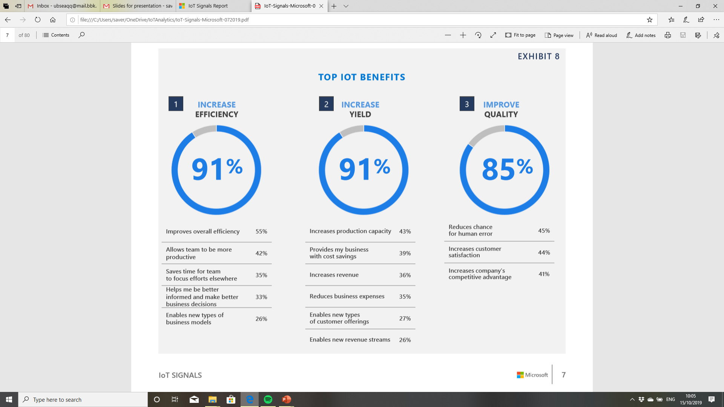
IoT was enabling digital transformation Source: Microsoft IoT Signals Research Sample: 3233 company decision makers
Pre-Covid 19 Phase
The energy of the
digital transformation
paradigm

Slide 6
But large majority of IoT projects were failing
Pre-Covid 19 Phase
The energy of the
digital transformation
paradigm
Microsoft: 30% of IoT projects fail in the proof-of-concept stage (June 2019)
Cisco: 76 Percent of IoT Projects Fail (April 2019)
Beecham Research: with up to 74% of companies considering their IoT projects to be unsuccessful. (February 2020)

Slide 7
There are challenges (technological and non technological) to face
Pre-Covid 19 Phase
The energy of the
digital transformation
paradigm
Security
Trust and privacy
Integration and interoperability
Scalability
Cloud and edge intelligence
Solution life-cycle management
Skills and new ways of working
Human-machine interaction
Prediction and automation

Slide 8
Two forces to address the challenges and shape market dynamics in 2020
Pre-Covid 19 Phase
The energy of the
digital transformation
paradigm
Simplifying IoT solution design and deployment
IoT Challenges
Moving the IoT to the era of prediction and automation

Slide 9
Simplification for reducing the ratio of IoT projects failure
Pre-Covid 19 Phase
The energy of the
digital transformation
paradigm
Device design for the specific context and requirements
One solution
One provider
One support
Simplifying IoT solution design and deployment
Global, reliable, cost-effective connectivity
Easy and secure integration with cloud system

Slide 10
The move towards prediction, automation, trust, and decentralisation requires a new era of convergences
Pre-Covid 19 Phase
The energy of the
digital transformation
paradigm
Predicting, Prescribing, Visualising
and Engaging
AR
AI
Trusted Decentralised and Distributed
Decision Making
Intelligent
Connectivity
IoT
DLT
5G

Slide 11
Covid-19 and life under WHO recommendations
Covid 19 Lockdown Phase
The stress test for the digital
transformation paradigm
Identify
Active surveillance and identifying the infected
Isolate
Isolate the infected from others
Quarantine
Partial and complete lockdown
Built on almost 20 years of pandemics: The Covid-19 is the peak of an era of pandemic crisis affecting our planet from the SARS pandemic in 2003 to Zika virus in Latin America in 2015 passing by the Avian influenza in 2006 H1N1 in 2009 and Ebola in 2014.
Christopher Wilson and Maria Garbrielsen Jumbert. 2018. The new informatics of pandemic response: humanitarian technology,
efficiency, and the subtle retreat of national agency. Journal of International Humanitarian Action

Slide 12
Techno- versus human-driven approaches for virus control
Covid 19 Lockdown Phase
The stress test for the digital
transformation paradigm
Identify
Active surveillance and identifying the infected
Isolate
Isolate the infected from others
Quarantine
Partial and complete lockdown
Techno-driven approach (China)
Identify → Ubiquitous surveillance systems (Chongqing, 2.6m cameras for 15.35 million people, 1 camera every six citizens); centralized data centre (sensors data); AI solutions for scanning (10-15s); drones for surveillance; IoT devices for tracking citizens movements; AI body thermo-scanners (Baidu, Megvii)
Isolate → AI supporting medical staff to understand data and emerging trends (GPU-accelerated AI such as Infervision), travel history of patients tested positive posted online, digital prevention system enabled self-registration of patients (Alibaba)
Lockdown → Each citizen has a QR code, which allows to track his or her movement. Drones for surveillance
Human-driven approach (Europe, USA)
Identify → Approach based on transparency, data protection and consensus. Use of aggregate mobile data and Internet data to understand citizens’ behaviour. Applications that enable people to share data if they want (Safe Paths, GeoHealth)
Isolate → Diverse use of technologies also due to the different levels of decision makings (Central state versus regional authorities)
Lockdown → National lockdown approach as key way through with the use of technologies for assisting living and healthcare and social care activities
Rama Krishna Reddy Kummitha. April 2020. Smart Technologies for fighting pandemics: The techno- and human- driven
Approaches in controlling the virus transmission. Government Information Quarterly.

Slide 13
Virus Control and the impact on organisations
Covid 19 Lockdown Phase
The stress test for the digital
transformation paradigm
Identify
Active surveillance and identifying the infected
Isolate
Isolate the infected from others
Quarantine
Partial and complete lockdown
Social distancing and lockdown
New non remote working scenarios
Smart Working
Different forms of smart working
Source: Interviews with decision makers in public and private organisations. Work in progress

Slide 14
Virus control and cities and communities
Covid 19 Lockdown Phase
The stress test for the digital
transformation paradigm
Identify
Active surveillance and identifying the infected
Isolate
Isolate the infected from others
Quarantine
Partial and complete lockdown
Social distancing and lockdown
Elderly and people in need remote assistance and care
Remote activities (smart working, home schooling, food deliveries, entertainment)
Decreasing levels of pollutants
Source: Interviews with decision makers in public and private organisations. Work in progress

Slide 15
Nitrogen Dioxide Concentration – Let’s not forget this comparison
Covid 19 Lockdown Phase
The stress test for the digital
transformation paradigm
Source: European Copernicus

Slide 16
The technological and organisational implications of smart working
Covid 19 Phase 1 and beyond
Does the digital transformation
paradigm need to be re-thought?
Smart Working is the opportunity to accelerate digital transformation in organisations supporting them in living phase 2 and beyond
The opportunity of running remotely routinized and creative working tasks
The opportunity of remotely monitoring and controlling machines and assets
The opportunity of creating remote human-machine interactions
Source: Interviews with decision makers in public and private organisations. Work in progress

Slide 17
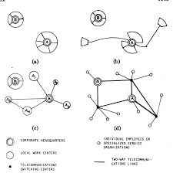
Smart Working is the opportunity of re-thinking mobility and living spaces in name of quality of life
Covid 19 Phase 1 and beyond
Does the digital transformation
paradigm need to be re-thought?
The paper “discusses the definition of telecommuting in two different contexts. In the first case, telecommuting is considered in the abstract, in the context of a variety of other remote work options. Each of the remote work options is classified according to its transportation impacts and its managerial implications. In the second case, the efforts of one group to define non-home-based telecommuting in the specific context of an air quality regulation designed to reduce travel are documented.”
Patricia L Mokhtarian, Defining Telecommuting, Georgia
Institute of Technology, 1991.
Jack M.Miles “Telecommunications and Organisational Decentralisation” IEEE Transactions in Communications, 1975

Slide 18
How can digital transformation help?
Covid 19 Phase 1 and beyond
Does the digital transformation
paradigm need to be re-thought?
Industry 4.0
Tourism
Elderly and people in need
Remote and real-time visibility of resources and activities
3D printing for spare parts and smart contract-based exchange
Immersive realities for remote control of machines
AI for assessing status and predicting conditions
Immersive realities (VR) for marketing
Drones for social distancing monitoring
Re-thinking home caring through smart buildings/smart home solutions
Ambient and assisted living solutions for patients and carers
Source: Interviews with decision makers in public and private organisations. Work in progress

Slide 19
Conclusions
Emerging digital technologies
can support organisations.
But, this is also an opportunity
to design sustainable and secure
digital transformation strategies for
new working and living spaces.
Many other issues to address:
- innovation collaboration
- global dynamics
- investing in digital technologies
- role of Europe
Emerging digital technologies
have shown their value in a
state of emergency like Covid 19
lockdown.
They have also shown the
potential of exploring new ways
of organising living and working
communities
Pre-Covid 19 Phase
The energy of the
digital transformation
paradigm
Covid 19 Lockdown Phase
The stress test for the digital
transformation paradigm
Covid 19 Phase 1 and beyond
Does the digital transformation
paradigm need to be re-thought?
Post-Covid 19 Phase
Can we take the all experience and build a different view?

Slide 20
Thank you
Saverio Romeo
s.romeo@bbk.ac.uk @saverio_romeo

