Slide 1
Why do we need science-based co-creation?
Muthu De Silva, Leonid Gokhberg, Dirk Meissner, Margherita Russo

Slide 2
Co-creation processes: an analytical framework building on the TIP project
TIP’s Definition on co-creation
Co-creation refers to:
the process of joint knowledge production between industry, research and possibly other stakeholders, such as civil society.
Thus, co-creation entails systemic relations based on partnerships between different stakeholders.
Moving beyond the linear model of unidirectional knowledge exchange from science to industry where academia acts as the knowledge producer and industry as the receiver and user p. 3 - Knowledge co-creation in the 21st century; An overview of global trends and policy implications

Slide 3
to looking forward at mechanisms, determinants and outcome of co-creation processes
Emphasising on the heterogeneity of co-creation mechanisms, in relation to the simultaneous generation of social values and business value.
Highlighting the different mechanisms of co-creation in terms of:
Scope of innovation i.e. different types of innovation ranging from technologies to capabilities
Reach i.e. whether the value reaches a broader or focused group of recipients
Prominence i.e. the balance between social and business values
→provides a framework to capture and assess values (in the short-term and long-term) and their heterogeneity
Discussing the determinants of this heterogeneity
greater attention to individual, meso and macro levels
→ to derive stronger policy implications as ‘one-size-fits-all’ model doesn’t work
Predominant social values
Combination of social values and business value
Predominant business value

Slide 4
Science-based co-creation examples
Accelerating technical solutions
Seed Funding and Investor Network Connection
Foreign Commonwealth Office
EJF Philanthropies
Technology Developers
PorePrint from City of London Police (Video here) – King’s College
AudioMoth from Open Acoustics (Video here)
Panda Sat from World Wildlife Fund (Video here) - Stanford University, the University of Colorado Boulder
WPSWatch from Wildlife Protection Solutions (Video here)
Field Expertise, Network building, and Business model development
1. Digital Catapult
2. Satellite Application Catapult
Technical infrastructure, Training and Free services
1. Amazon Web Services
2. Microsoft
User co-creation and subject matter expertise
1. Six Wildlabs conservation partners
2. WILDLABS.NET

Slide 5
mechanisms, determinants and outcome of co-creation processes

Slide 6
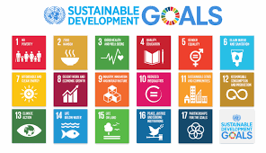
The rationale for public policy supporting co-creation 1/3
Dimension: Decision to engage in co-creation → Nature of value co-created
Scope of the challenge, Urgency of response → Evaluate when and for what purpose co-creation is suitable → Increases the chances of success e.g. to achieve SDG, Covid-19 response
Objectives and incentives for engagement – Organizational policies on incentives (e.g. university incentives), Government policies as to how to incentivize co-creation as a tool to enhance social and economic value creation

Slide 7
The rationale for public policy supporting co-creation 2/3
Dimension: Inputs to co-creation by actors → Nature of value co-created
Tangible and intangible resources
Government policies as to how to support co-creation by offering specific resources (i.e. resource needs vary depending on the value to be co-created) as a tool to enhance social and economic value creation,
Organizational and co-creation initiative policies – decide which resources are required and what resources could be offered by each organizations to generate specific values. Enhanced opportunities for combining basic and applied research
Dimension: Managing co-creation → Nature of value co-created
Partnership model Clear decision making on which partners are required to generate which types of value e.g. local vs international actors, working with actors from different disciplines
Organization, capabilities, practices Policies at both organisational and government level to understand which training need to be provided and absorptive capacities to be enhanced to generate specific forms of value
Digital infrastructure Policies on which digital infrastructure should be offered for specific forms of co-creation
Intellectual property rights Government policies on IP support to be offered and organizational/co-creation policy level to decide strategic use of IP policies/regulations

Slide 8
The rationale for public policy supporting co-creation 3/3
Nature of value co-created Provides a framework for policy makers and other organisations involved in co-creation to capture and evaluate benefits
Implications:
performance metrics within organisations
evaluation criteria of policy programmes
dual value associated to policy interventions
Dimensions | Social values |  | Business value
 | Short-term | Long-term | Short-term | Long-term
1. Scope of Innovation
2. Reach
3. Prominence

Slide 9
Thank you
Muthu De Silva, Associate Professor, Birkbeck, University of London, United Kingdom, m.desilva@bbk.cc.uk
Leonid Gokhberg, First Vice Rector National Research University Higher School of Economics and Director Institute for Statistical Studies and Economics of Knowledge, Moscow, Russia, and Delegate at the Oecd-CSTP and NESTI, lgokhberg@hse.ru
Dirk Meissner, Head International Laboratory Economics of Innovation, National Research University Higher School of Economics, Moscow, Russia, and Delegate at the Oecd-TIP, dmeissner@hse.ru
Margherita Russo, Dipartimento di Economia Marco Biagi, Università di Modena e Reggio Emilia, Italy, and Vice Chair of Oecd-TIP Bureau, margherita.russo@unimore.it

Slide 10
Additional slides for Q&A
Excerpted from the working paper available at
https://wp.hse.ru/data/2020/06/10/1606381216/109STI2020.pdf | https://papers.ssrn.com/sol3/papers.cfm?abstract_id=3622508

Slide 11
Co-creation: toward an analytical framework bringing us forward
Tip’s definition | Definition used in the presentation
1. Process of joint knowledge production between industry, research and possibly other stakeholders, such as civil society. | A collaborative approach between actors associated with different organisations – including universities, businesses, government, intermediaries and society
2. Entails systemic relations based on partnerships between different stakeholders, moving beyond the linear model of unidirectional knowledge exchange from science to industry where academia acts as the knowledge producer and industry as the receiver and user | Actors work together closely by integrating different assets- including knowledge, resources and networks (i.e. in comparison to knowledge transfer and exchange that are aimed at acquisition rather than integration)

Slide 12
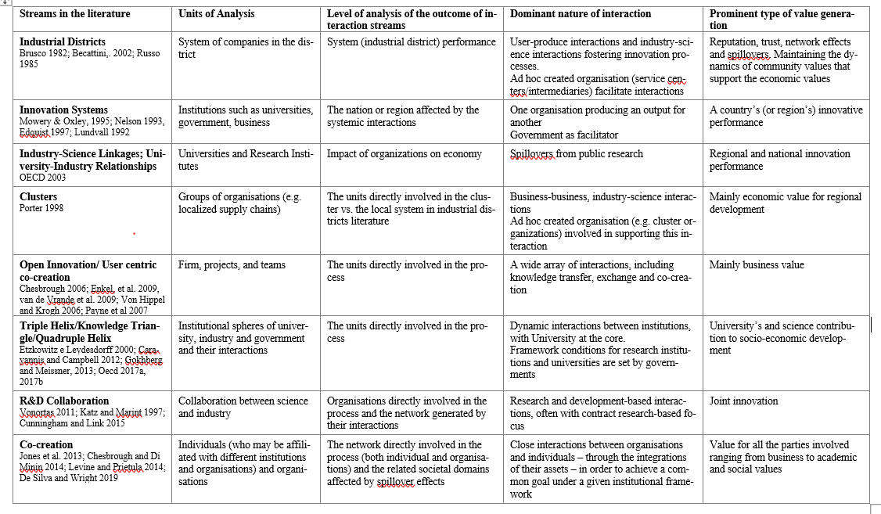

Slide 13
Co-creation initiatives: heterogeneity in terms of social and business values generated
SCOPE OF INNOVATION
Technology
Products, Equipment, Software, and Materials
Knowledge
Handbooks, Training programs, Data bases, and Market knowledge
Capabilities
Entrepreneurial, Innovation, Scientific, Managerial, and Relational, capabilities
Knowhow
Recipes, Protocols, and Scientific process
REACH
Focused group – e.g. a corporate accelerator or joint-lab
Broader group – e.g. social innovation lab
PROMINENCE balance between social and business value
Social innovation lab
Predominant social value | Dementia friendly community
Indirect business value | Local bus. growth
Joint-research lab
Predominant business value | Commercialising the output
Indirect social value | Capability develop.

Slide 14
science-based co-creation examples
Accelerating technical solutions
Seed Funding and Investor Network Connection
Foreign Commonwealth Office
EJF Philanthropies
Technology Developers
PorePrint from City of London Police (Video here) – King’s College
AudioMoth from Open Acoustics (Video here)
Panda Sat from World Wildlife Fund (Video here) - Stanford University, the University of Colorado Boulder
WPSWatch from Wildlife Protection Solutions (Video here)
Field Expertise, Network building, and Business model development
1. Digital Catapult
2. Satellite Application Catapult
Technical infrastructure, Training and Free services
1. Amazon Web Services
2. Microsoft
User co-creation and subject matter expertise
1. Six Wildlabs conservation partners
2. WILDLABS.NET

