Slide 1
Understanding the evolution of the entrepreneurial university:
The case of English Higher Education Institutions
Paper available in Higher Education Quarterly
DOI: 10.1111/hequ.12230
Mabel Sánchez-Barrioluengo (University of Manchester)
Elvira Uyarra(University of Manchester)
Fumi Kitagawa (University of Edinburgh)

Slide 2
Background
  Growing policy pressures with ever-growing missions and roles for HEIs : education, research, commercialisation, civic/community engagement, regional development…..
  The ‘entrepreneurial university’ discourse:
    ‘a global phenomenon with an isomorphic developmental path’ (Etzkowitz & Leydesdorff, 2000, p. 313)
    there is ‘no typical way to become an “entrepreneurial university”’ (Lawton Smith & Bagchi‐Sen, 2010, p. 806).
    Dynamics, diversity and heterogeneity behind the concept (Tuunainen, 2005; Martin, 2012; Sánchez‐Barrioluengo & Benneworth, 2019)
    Stakeholder choices and ‘lock in’(De la Torre, Rossi, and Sagarra 2018)
    Isomorphic pressures VS heterogeneous evolution paths towards an entrepreneurial university (Pinheiro & Stensaker, 2014)

Slide 3
Gaps and Objective
Gaps
  Limited understanding of the dynamics of change underpinning third mission/Knowledge Exchange (KE) activities
  Longitudinal perspective VS cross-sectional analysis
  determinants of third mission engagement but not much on evolution
  Tensions between:
    Policies promoting and incentivising third mission activities
    Capacity of universities to balance diverse tasks
Objective
To shed light on the heterogeneous evolution of KE interactions of universities:
breadth of KE activities, geographical dimension and partners

Slide 4
Research questions
In what ways have universities responded to the pressure to be more entrepreneurial?
How have the third mission profiles of universities changed and evolved over time in terms of KE activities and partnerships?

Slide 5
Unpacking third mission activities and the stakeholders
Breadth of knowledge-exchange (KE) activities
External partners (e.g. large firms, SMEs, public sector etc)
Geographical (regional) dimension
Evolution of interactions

Slide 6
1) Breadth of knowledge-exchange activities
  ‘‘Academic entrepreneurship’ or ‘hard activities’: patents, licenses and spin-off
  Academic engagement’ or ‘soft activities: consulting, advisory roles, industry training, student placements
  Narrow policy emphasis overlook interconnections and complementarities
  Different types of universities have a mix of missions and KE activities:
    Research intensive universities focus on exploitation of IP
    ‘Newer universities’ more teaching focus and ‘locally oriented’
    Balance and Interconnections of third mission and other missions
(Philpott et al., 2011)
  (Perkmann et al., 2011)
  (Uyarra, 2010)
(Hewitt-Dundas, 2012; Guerrero et al., 2015)
(Charles et al., 2014; Goddard et al., 2014;
Kitagawa et al., 2016)
(Sánchez‐Barrioluengo, 2014; Degl'Innocenti et al.,2019)

Slide 7
2) Knowledge exchange partners
  Mix of partners and stakeholders in interactions: private VS public, SMEs VS large firms, non-profit institutions
  Stakeholders choices and constraints
    Large companies work with a research intensive university because of reputation
    Small firms demand routine services and consultancy
    KE with public and third (not for profit) sectors is an important yet neglected aspect
(De la Torre, Rossi, and Sagarra 2018)
(Laursen et al., 2011)
    (Siegel et al., 2007; Pinto et al., 2013)
    (Hughes and Kitson, 2012)

Slide 8
3) Geographical dimension
  Importance of localised knowledge spillovers
  Spatial dimension of collaboration - far from simple and uniform
    Characteristics of the region, including the presence of innovation support structures and structural characteristics of firms.
    Newer universities tend to give engagement with regional stakeholders a greater priority compared to more established ones.
    Older universities more likely to interact with a more diverse range of orgaisations and with organisations located outside their own region.
(Audretsch et al., 2005)
  (D’Este and Iammarino, 2010; Laursen et al., 2011; Huggins et al., 2012)
(D'Este & Iammarino, 2010; Hewitt‐Dundas, 2012; Lawton Smith & Bagchi‐Sen, 2010)
(Uyarra, 2010)
(Huggins, Johnston, and Stride, 2012)

Slide 9
4) Evolutionary interactions
  University ‘path dependent’ product of social, economic and institutional development
  Adaptation of strategies to the environment (Jacob et al., 2003)

Slide 10
Evolving HE-KE system(s) in England
Third mission policy and third mission funding since late 1990s
Acknowledgement of the diversity of the system
Third mission funding formulae
Change in regional/local KE governance (c.f. RDA; ERDF)
Tensions with “one size fits all” policy mechanisms
More granulated ‘typology’ of HEIs and KE activities…(e.g. KEF)
(e.g. Sainsbury 2007)
(Rossi and Rosli, 2015)
(Charles et al., 2014)
(Kitagawa et al., 2016)

Slide 11
Typology and Source of data

Slide 12
KE activities variables
Methodology: factor analysis (principal components technique with Kaiser Normalization.
Total variance explained: 0.689)
RESEARCH-ORIENTED
(Eigenvalue: 4.44; Exp. Var.: 0.30)
CONSULTANCY
(Eigenvalue: 1.48; Exp. Var.: 0.10)
FACILITIES
(Eigenvalue: 1.56; Exp. Var.: 0.10)
TRAINING
(Eigenvalue: 1.46; Exp. Var.: 0.10)
SPIN-OFFs (Eigenvalue: 1.46; Exp. Var.: 0.10)

Slide 13
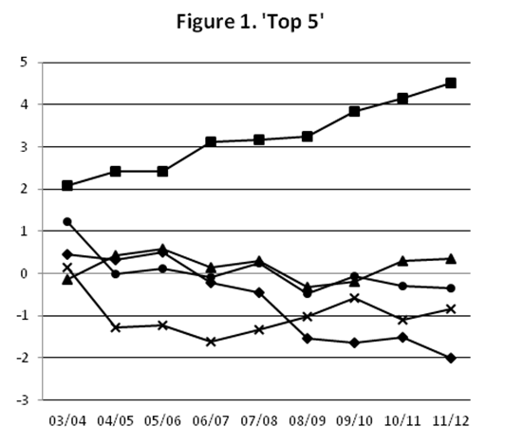
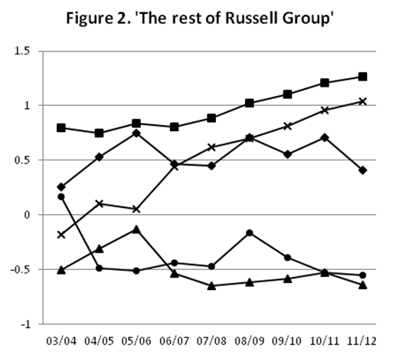
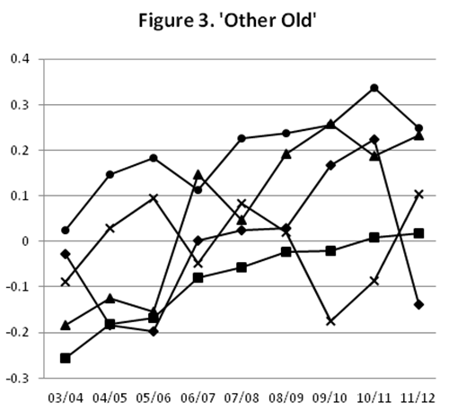
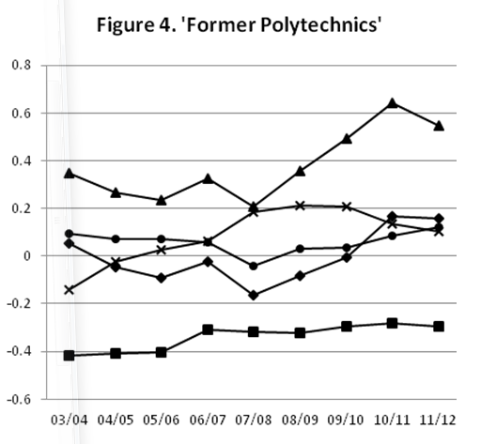
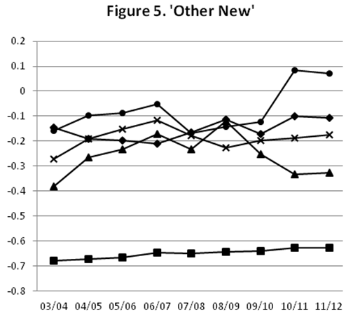

Evolution of KE activities by university cluster
RESEARCH-ORIENTED
MIX
CONSULTANCY
SPIN-OFFs
Methodology: factor scores standardized over time

Slide 14
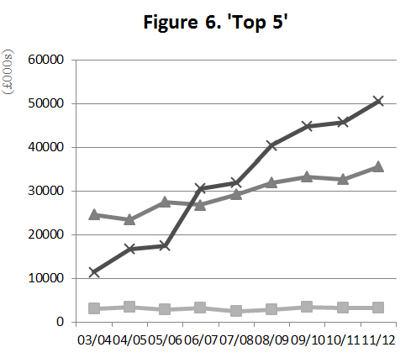
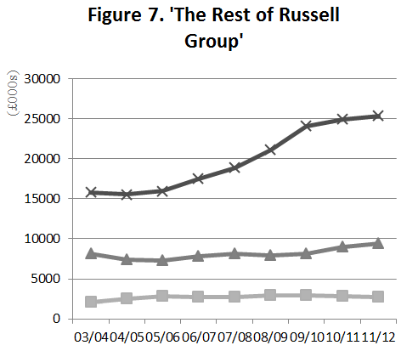
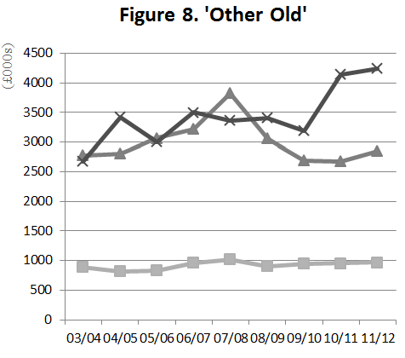
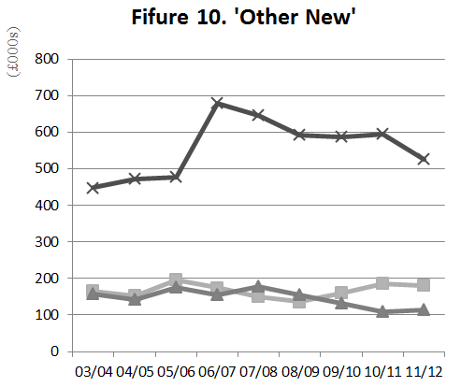
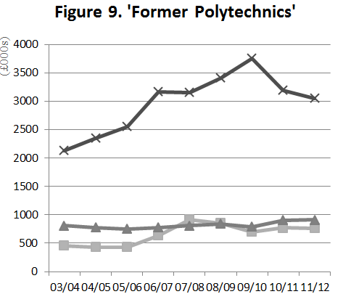

Evolution of KE income by partners
Non-Commercial
Non-SMEs
MIX
Non-Commercial
Annual Growth Rates
Total KE act.: 6%
Non-Com: 8.5%
Private: 2.5%
SMEs: 2.8%
Non-SMEs: 2.6%
Non-Commercial
SMEs
Non-Commercial
Notes:
There is a stark differences across institutional types.
KE income increased in the period for all groups, particularly for Top 5 and the Rest of Russell Group universities (on average the annual growth has been 10.3% and 5.5% respectively). Russell group universities (Top Five and the Rest of Russell Group) exhibit the biggest growth in income from KE activities with non‐commercial organisations (16% and 7.2% respectively) whilst Former Polytechnics experienced the greatest increase in income from SMEs (7.5% compared with less than 2.5% for other universities).
Top Five universities benefited from the largest increase in income from large firms (5%), while Other New universities experienced the biggest drop in KE income from large firms (−4.2%).

Slide 15
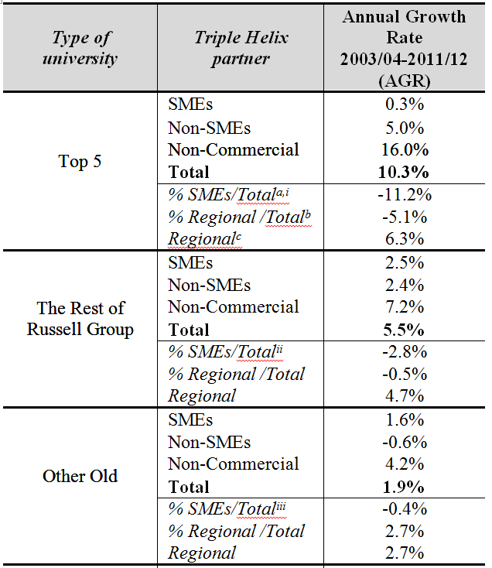
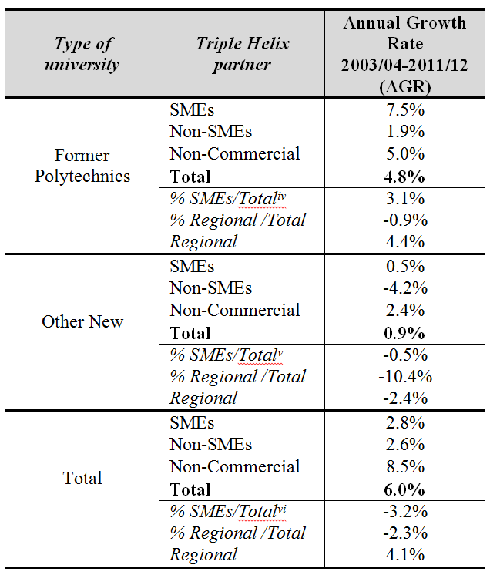
Annual Growth Rate in KE income by partners
Partners
Partners
Notes:
a significant drop in income growth from all actor types, namely, SMEs, large firms and non‐commercial organisations, from 2007/08 onwards. The decline in income from KE interactions with firms (industry helix) and non‐commercial organisations (the government helix) may reflect the effects of the economic crisis and the following public sector funding cuts. This reduction is particularly severe for newer universities, which tend to be reliant on KE income from SMEs and public sector organisations, particularly at the local level. The trend towards greater selectivity and differentiation has intensified since 2007/08, which coincides in time with the economic slowdown as well as with a series of policy changes influencing regional development and Higher Education landscapes in England

Slide 16
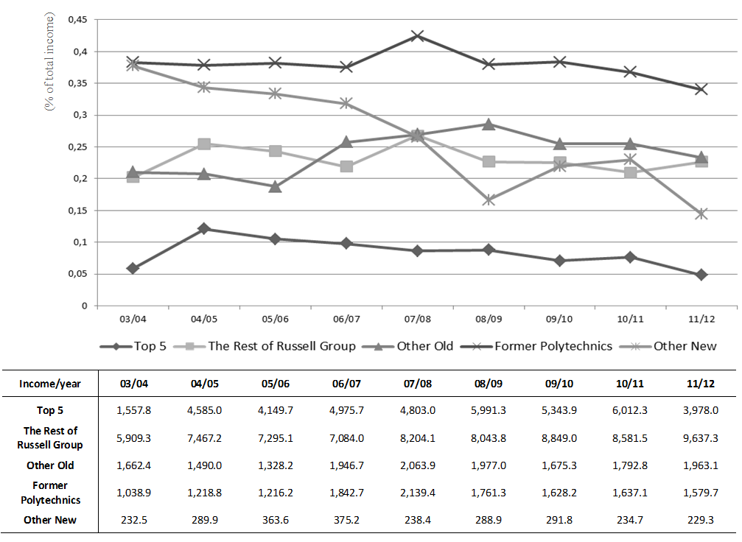
Evolution of regional KE income
Methodology: evolution of regional income (share and total) from KE activities
Annual Growth Rates
Total regional income: 4.1%
Share of regional income: -2.3%
Notes:
he data shows a slight increase (4.1%) of income from regional interactions in the full period, however the regional share of the total income decreased by 2.3 per cent. Further, we can observe stark variations in the two periods analysed. The positive trend (9.7%) in engagement with regional stakeholders in the first period (2003/04–2007/08) contrasts with a reduction of the regional income for HEIs of around −0.3% after the crisis.
All universities exhibited a positive growth of regional KE income in the first period, with Former Polytechnics being the ones with the higher growth (18.9%), followed by Top Five universities having increased regional income by 17.1 per cent. The decline has been shaper in recent years with the exception of the Rest of Russell Group that is the only group with a positive growth in both periods (5.8% in 2003/04–2007/08 and 3.9% in 2008/09–2011/12).
For the rest, after 2007/08 all groups reduced their interaction with regional actors, both in terms of their overall regional engagement and as a proportion of total KE income.
This decline in the total and the share of regional engagement has been particularly marked for Former Polytechnic universities (−7.1% and −4.8% respectively) and Top 5 (−3.1% and −11.8%).

Slide 17
Summary of findings – university types, KE activities, partners and geography
 | KE activities | partner | Geography of interaction | Observations
Top 5 | Research-oriented activities | Large firms and Non-commercial organisations |  | Greater resilience and adaptation to policy changes. ‘Harder’ forms of engagement Better positioned to diversify funding sources
Rest of Russell Group | Research-oriented activities | Non-commercial organisations
Other ‘Old | Mix | Mix |  | Broad range of KE activities and partners with low specialization
Former Polytechnics | Consultancy | Non-commercial organisations SMEs | Within the region | Public spending cuts Lower demand for KE by the public sector Diminished resources for KE (particularly with SMEs)
Other ‘New’ | Spin-offs | Mix

Slide 18
Behind the entrepreneurial university:
The dynamics of KE activities over time
The temporal dimension in the analysis of the entrepreneurial university.
Evolution of the KE activities
macro-level external pressures including government third mission policy and external shocks
micro-level institutional practices, strategies and re-positioning of individual HEIs –
2) Selectivity of KE activities and external partners
  differentiation and specialisation as well as path dependency in their patterns of interactions
  Constraints in local and regional engagement and SMEs
  Multi-level perspectives needed – e.g. individual academics, universities, external partners

Slide 19
Implications from the study and remaining issues
Third mission policy – broadening scope and recognition of diversity but still limited – e.g. metrics of KE; capturing different impacts?
- c.f. Knowledge Exchange Framework (KEF)
“intended to increase efficiency and effectiveness in use of public funding for knowledge exchange (KE), to further a culture of continuous improvement in universities by providing a package of support to keep English university knowledge exchange operating at a world class standard. It aims to address the full range of KE activities”.
Recognising and balancing research–third‐mission nexus vs teaching/education–third‐mission nexus (Siegel & Wright, 2015; Healey, Perkmann, Goddard, & Kempton, 2014).
Vulnerability of HEIs and specific places (Goddard et al., 2014)

Slide 20
ACKNOWLEDGMENTS
We would like to thank Dr. Federica Rossi for valuable comments, which led to a substantial improvement of the manuscript.
An earlier version of the paper was presented at the Triple Helix Conference (Manchester, September 2018) where insightful comments were received from the participants.
Any remaining errors are the responsibility of the authors, and the views expressed in this paper are purely those of the authors.
THANKS FOR LISTENING!

