Slide 1
University profiles and efficiency performance: an institutional characterization for Spanish universities
Eva M. de la Torre
Universidad Autónoma de Madrid
Fernando Casani
Universidad Autónoma de Madrid
Marti Sagarra
Universitat de Barcelona
Centre for Innovation Management Research
Birkbeck, University of London, March 2019

Slide 2
1 MOTIVATION
1.1 Heterogeneity in the HE sector
Heterogeneity in HE sectors
No comparability
Hinder deep understanding of HE sector
Global and national rankings
Institutional strategies
Evaluation agencies
EHEA, ERA
Homogenising pressures

Slide 3
2 THEORETICAL FRAMEWORK
2.1 Sources of heterogeneity in HE
Types of heterogeneity | Sources of heterogeneity
Horizontal heterogeneity | Teaching Research Third mission | Related to: Range of activities undertaken Target
Vertical heterogeneity | Type of HEI Research quality | Related to: Scientific production Post-graduate teaching HE funding systems
Source: author’s elaboration based on Daraio et al (2011).

Slide 4
2 THEORETICAL FRAMEWORK
2.2 Previous classification attempts
 | Unidimensional | Multidimensional
Ex-ante or prescriptive | Ad-hoc classifications (I) Legal status Size Location International orientation Scope Subject mix | Classifications of institutions Carnegie clasification U-Map and U-Multirank U-Ranking
Ex-post or descriptive | Ad-hoc classifications (II) Gómez-Sancho (2005) Gómez-Sancho and Mancebón Torrubia (2008) Vázquez Rojas (2011) | Classifications of ‘comparable’ institutions Carnegie clasification Bonaccorsi and Daraio (2009) García-Aracil and Palomares-Montero (2012) Schubert et al. (2014)
Source: de la Torre, Casani and Sagarra (2018).

Slide 5
2 THEORETICAL FRAMEWORK
2.3 Diversity and efficiency in university evaluation
Purpose | Method | University behaviour
1. Funding distribution | (synthetic) indicators and quantitative Specific, comparable results | Aim → to achieve indicators’ levels Objective shifts and homogenisation
2. Auditing
3. Formative | Qualitative Processes and details | Self-learning process No incentives to show particular results Respectful to diversity
Source: Molas-Gallart (2015)

Slide 6
3 OBJECTIVES
Assessment method:
Formative evaluation
Acknowledges of horizontal and vertical diversity
Allows comparability and deeper understanding of HE
Acknowledges third mission as a source of diversity
Bootstrap Data Envelopment Analysis (DEA) + Multidimensional Scaling (MDS)
(R). Is (in)efficiency related to a particular typology of university?
(H). Different typologies of universities are related to different efficiency levels

Slide 7
3 OBJECTIVES
Assessment method:
Formative evaluation
Acknowledges of horizontal and vertical diversity
Allows comparability and deeper understanding of HE
Acknowledges third mission as a source of diversity
Bootstrap Data Envelopment Analysis (DEA) + Multidimensional Scaling (MDS)
We define typologies of universities based on:
Their characteristics
Their efficiency orientation

Slide 8
4 METHODLOGY
4.1 Ordinal MDS
Allows to position the n units of observations (DEA scores and descriptive ratios) on a multidimensional map
The distances between observations are mapped into a set of coordinates in a m-dimensional space
Once chosen the optimal number of dimensions m → projection of the observations into two-dimensional maps for each pair of dimensions at a time

Slide 9
4 METHODLOGY
4.2 Data Envelopment Analysis
Frontier method
Non-parametric
Multi-input and multi-output approach
Results:
Efficient universities: score =1
Inefficient universities: score < 1
Variable returns to scale, output orientation

Slide 10
4 METHODLOGY
4.2 MDS-DEA
Two types of variables:
Efficiency scores (Bootstrap DEA)
Descriptive ratios
Sample:
47 Spanish public on campus universities
Academic year: 2013-14

Slide 11
4 METHODLOGY
4.3 Characterisation ratios
Dimension |  | Ratio | Ratio description
Structure of faculty staff | 1 | fte_hc | Academic staff (FTE) / Academic staff (HC)
Structure of the student body | 2 | bach_enrol | Bachelor enrolment / (Bachelor and master) enrolment
Teaching subject mix | 3 | humsc_grad | (Bachelor and master) Grads. in Social & Humanities / Total grads.
 | 4 | sci_grad | (Bachelor and master) Graduates in Sciences / Total graduates
 | 5 | eng_grad | (Bachelor and master) Graduates in Engineering / Total graduates
 | 6 | med_grad | (Bachelor and master) Graduates in Medicine / Total graduates
Research subject mix | 7 | humsc_pub | Papers (Social Sciences & Humanities) / Total Papers
 | 8 | sci_pub | Papers (Sciences) / Total Papers
 | 9 | eng_pub | Papers (Engineering) / Total Papers
 | 10 | med_pub | Papers (Medicine) / Total Papers
T productivity | 11 | grad_fte | (Bachelor + Master) graduates / Academic staff (FTE)
R productivity | 12 | pub_fte | Papers / Academic staff (FTE)
KT productivity | 13 | KTinc_fte | Income from R&D and consultancy contracts, technical services rendered, company-sponsored chairs and agreements on IIP / Academic staff (FTE)
T success | 14 | grad_enrol | (Bachelor and master) Graduates / (Bachelor and master) enrolment
R success | 15 | cit_pub | N. citations / N. papers
KT success | 16 | KTinc_inc | Income from KT as defined above / Total income
Size | 17 | size | Total expenditure
Source: de la Torre, Casani and Sagarra (2018).

Slide 12
4 METHODLOGY
4.4 DEA scores
 | Model | Inputs | Outputs
18 | A1 | A (academic staff FTE) | 1 (graduates)
19 | AB1 | A, B | 1
20 | B1 | B (expenditure) | 1
21 | A2 | A | 2 (publications)
22 | AB2 | A,B | 2
23 | B2 | B | 2
24 | A3 | A | 3 (KT income)
25 | AB3 | A,B | 3
26 | B3 | B | 3
27 | A12 | A | 1,2
28 | AB12 | A,B | 1,2
29 | B12 | B | 1,2
30 | A13 | A | 1,3
31 | AB13 | A,B | 1,3
32 | B13 | B | 1,3
33 | A23 | A | 2,3
34 | AB23 | A,B | 2,3
35 | B23 | B | 2,3
36 | A123 | A | 1,2,3
37 | AB123 | A,B | 1,2,3
38 | B123 | B | 1,2,3
Source: de la Torre, Casani and Sagarra (2018).

Slide 13
5 RESULTS
Source: de la Torre, Casani and Sagarra (2018).

Slide 14
5 RESULTS
4.1 Results – bs3p – dim1 vs. dim2
Source: de la Torre, Casani and Sagarra (2018).

Slide 15
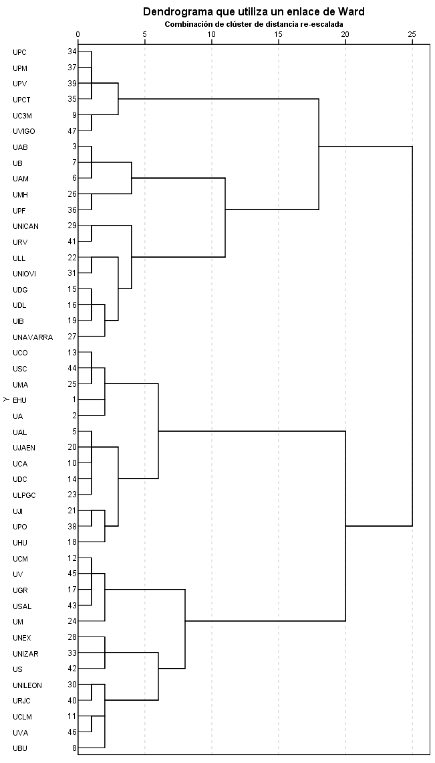
5 RESULTS
5.2 Typologies of universities (I)
Source: de la Torre, Casani and Sagarra (2018).

Slide 16
5 RESULTS
5.2 Typologies of universities (II)
Typology | University | Typology | University
Cluster 1 Universities oriented towards efficiency in the traditional missions (particularly teaching) | EHU | Cluster 3 Universities oriented towards overall efficiency | UBU
 | UA |  | UCLM
 | UAL |  | UNEX
 | UCA |  | UNILEON
 | UCO |  | UNIZAR
 | UDC |  | URJC
 | UHU |  | US
 | UJAEN |  | UVA
 | UJI | Cluster 4 Universities oriented towards efficiency in KT | UC3M
 | ULPGC |  | UPC
 | UMA |  | UPCT
 | UPO |  | UPM
 | USC |  | UPV
Cluster 2 Universities oriented towards efficiency in research | UAB |  | UVIGO
 | UAM | Cluster 6 Regional universities oriented towards efficiency in research and KT | UDG
 | UB |  | UDL
 | UMH |  | UIB
 | UPF |  | ULL
Cluster 5 Universities oriented towards the efficiency in the traditional missions | UCM |  | UNAVARRA
 | UGR |  | UNICAN
 | UM |  | UNIOVI
 | USAL |  | URV
 | UV
Source: de la Torre, Casani and Sagarra (2018).

Slide 17
5 RESULTS
5.2 Typologies of universities (III)
Main statistics on the coordinates for the university vectors and overall efficiency by cluster
Clusters |  | DIM_1 | DIM_2 | DIM_3 | DIM_4 | DIM_5 | DIM_6 | AB123 | N
1 | Mean | 0.231 | 0.384 | -0.208 | -0.386 | 0.101 | -0.007 | 1,746 | 13
 | SD | 0.152 | 0.285 | 0.219 | 0.186 | 0.329 | 0.150 | 0,199
2 | Mean | 0.172 | -0.715 | 0.009 | -0.038 | -0.001 | -0.019 | 1,216
 | SD | 0.164 | 0.125 | 0.297 | 0.288 | 0.208 | 0.184 | 0,068 | 5
5 | Mean | 0.659 | -0.106 | 0.266 | 0.132 | 0.297 | 0.154 | 1,252
 | SD | 0.092 | 0.236 | 0.078 | 0.152 | 0.160 | 0.252 | 0,117 | 5
3 | Mean | 0.115 | 0.284 | 0.341 | 0.355 | 0.063 | -0.122 | 1,247 | 8
 | SD | 0.270 | 0.215 | 0.337 | 0.258 | 0.314 | 0.168 | 0,186
4 | Mean | -0.736 | 0.079 | 0.165 | -0.195 | -0.053 | 0.068 | 1,393 | 6
 | SD | 0.258 | 0.148 | 0.146 | 0.207 | 0.208 | 0.148 | 0,251
6 | Mean | -0.108 | -0.091 | -0.532 | 0.222 | -0.193 | -0.039 | 1,342 | 8
 | SD | 0.312 | 0.289 | 0.203 | 0.135 | 0.191 | 0.312 | 0,144
Source: de la Torre, Casani and Sagarra (2018).

Slide 18
5 RESULTS
5.2 Typologies of universities (IV)
Main characteristics by cluster
Clusters | N | Univ. hosp. | % enrolment by field of knowledge |  |  |  | % publications by field of knowledge
 |  |  | ING | MED | SCI | HUMSOC | ING | MED | SCI | HUMSOC
1 | 13 | 7 | 21.59 | 12.81 | 6.27 | 59.33 | 27.02 | 23.05 | 58.25 | 17.55
2 | 5 | 4 | 8.38 | 21.56 | 10.71 | 59.34 | 12.02 | 41.17 | 52.42 | 14.07
3 | 8 | 7 | 24.01 | 13.22 | 5.36 | 57.41 | 32.55 | 23.29 | 54.55 | 16.94
4 | 6 | 1 | 74.91 | 1.19 | 2.22 | 21.68 | 54.01 | 7.90 | 55.06 | 11.39
5 | 5 | 5 | 7.86 | 19.21 | 8.88 | 64.05 | 17.41 | 31.64 | 55.00 | 18.80
6 | 8 | 7 | 22.19 | 16.47 | 6.44 | 54.90 | 25.43 | 22.34 | 60.37 | 16.10
Source: de la Torre, Casani and Sagarra (2018).

Slide 19
5 RESULTS
5.3 Typologies of universities (V)
Type of university | N | Characteristics
Universities oriented towards efficiency in the traditional missions (particularly teaching) | 13 | Regional universities, medium-size/small and mostly young universities. Low performance in KT and strong in humanities and social sciences.
Universities oriented towards efficiency in research | 5 | Mostly big universities located in metropolitan big areas (Barcelona and Madrid). The strongest specialization in health sciences.
Universities oriented towards the efficiency in the traditional missions | 5 | Big mostly old universities Teaching activity is strongly specialised in humanities and social sciences. Research performance relies on experimental sciences and medicine
Source: de la Torre, Casani and Sagarra (2018).

Slide 20
5 RESULTS
5.3 Typologies of universities (VI)
Type of university | N | Characteristics
Universities oriented towards overall efficiency | 8 | Regional universities medium-size/small universities mostly young. Rather balanced profile: humanities and social sciences, and technical and experimental sciences
Universities oriented towards efficiency in KT | 6 | The four polytechnic universities as well as other universities particularly efficient and/or active in KT
Regional universities oriented towards efficiency in research and KT | 8 | Regional, big/medium-size and mostly old universities Not strongly oriented towards efficiency in any mission but fairly performing in research + some activity in KT (experimental and technical sciences)
Source: de la Torre, Casani and Sagarra (2018).

Slide 21
6. SUMMARY
Evaluation of public policies and efficiency in public expenditure is increasingly demanded:
Evaluations and rankings usually assume homogeneity
Aim of the study → To propose and evaluation method that:
Respects and supports university diversity
Provides useful information for designing university policies and strategies to improve HE systems
Not aiming at → ranking of the best/worst performing universities

Slide 22
7. CONCLUSIONS
7.1 Relevant results for the specific case of Spanish HE system
Better and more robust acknowledgement of diversity
Heterogeneity of the Spanish HE system (path dependent):
Legally recognised: legal status (public or private)
Informally recognised: size and subject mix
But also: production mix (including the third mission)
Same policies ⇒ different results
Limitation: lack of data on third mission
Revision of the administrative datasets
Consideration of all the dimensions of the third mission in HEIs evaluation
Evidence-based policy making

Slide 23
7. CONCLUSIONS
7.2 Relevant results in the international context
HE policies and university strategies → more nuanced objectives can be defined
University managers → groups of peers and benchmarking
All university missions are made visible and recognised – including the third mission
Alternative evaluation method → evaluation can work as a tool for designing public policies and institutional strategies, not as a policy itself.

Slide 24
THANK YOU!
Eva M. de la Torre
eva.torre@uam.es
Fernando Casani
fernando.casani@uam.es
Marti Sagarra
martisagarra@ub.edu

