Slide 1
At what scale do KIBS act?
An overview of some Canadian research
and orientations for future work.
Richard Shearmur, INRS, Université du Québec
richard.shearmur@ucs.inrs.ca
and David Doloreux, Telfer School of Management, University of Ottawa
Regional Science Association, London, 28th March 2011

Slide 2
Introduction
1- KIBS and/or high order services
2- Why bother about scale?
3- Some results
4- Where do we go from here?

Slide 3
1- KIBS and/or high order business services
‘Business’ Services:
that deal with part of the production process (Miles, 2007)
that are intermediate (i.e. whose clients are principally other businesses)
‘High-order’ / ‘Knowledge intensive’
qualified workforce
symbolic analysts (Reich, 1992)

Slide 4
1- KIBS and/or high order business services
These services are vectors of knowledge transfer, and are thought to help other firms in their production and innovation processes (den Hertog, 2000; Muller, 2001).
Cooke & Leydesdorff (2006) argue that KIBS are an important part of local innovation systems.
If this is the case, then many localities will not innovate: they have very few KIBS!

Slide 5
2- Why bother about scale?
if KIBS are an important element in local and regional innovation systems
if KIBS are not to be found in most localities and regions
Then the questions arise:
- do KIBS operate a-spatially?
- do they operate at particular scales?

Slide 6
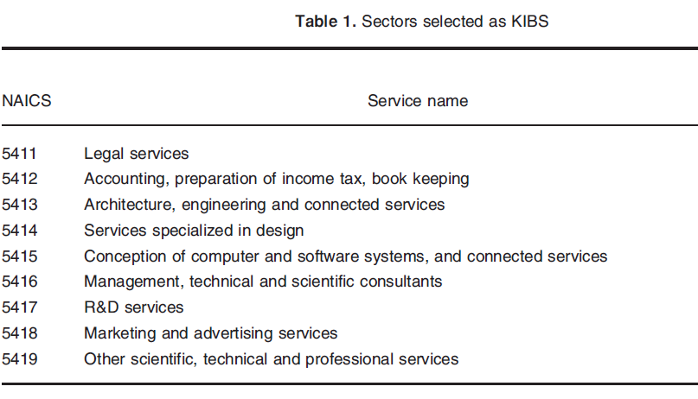
3. Some Results
In the following analyses KIBS are often taken to be NAICS 54

Slide 7
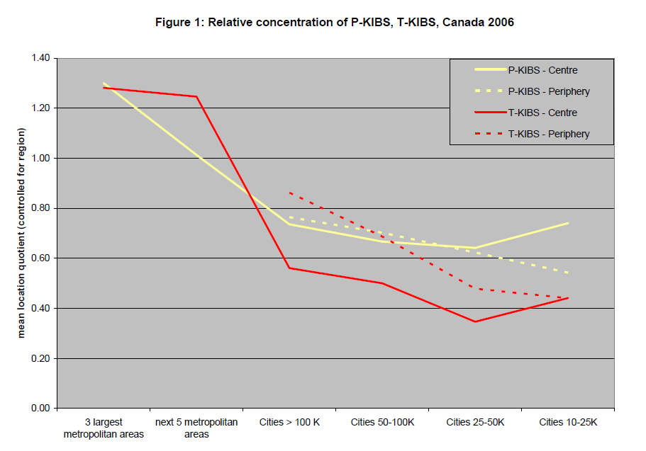
Shearmur, 2010
distance protection effect?
T-KIBS don’t only follow urban size: if
far from metro areas, local T-KIBS emerge?
no distance protection effect
P-KIBS are strongly present in largest cities, but are evenly distributed across
smaller cities – retail effect?

Slide 8
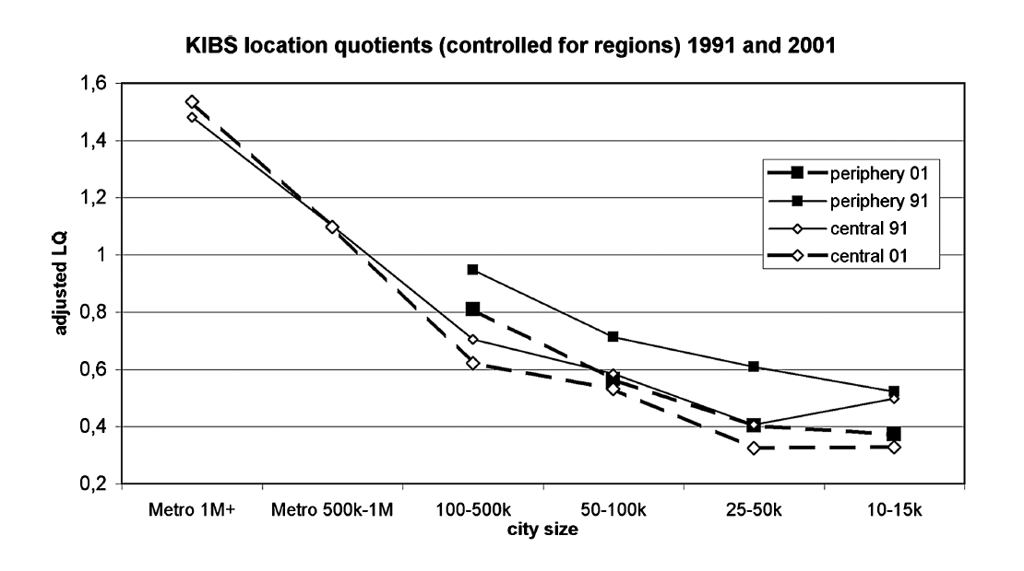
3. Some Results
Shearmur & Doloreux, 2008
decline of distance protection effect over time?
But maybe only for P-KIBS.

Slide 9
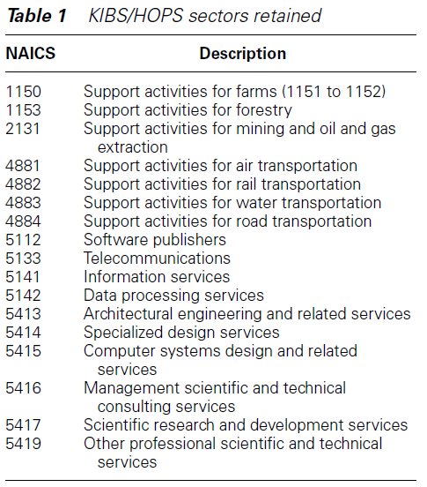
But wider selection ?
(Shearmur & Doloreux, 2008)
- it has been argued (Eberts &
Randall, 1998), that looking
only at NAICS 54 biases KIBS
studies towards metro areas.
- some of our other analysis
focusses on Technical KIBS, but
widens its scope beyond NAICS 54

Slide 10
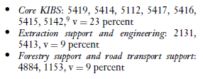
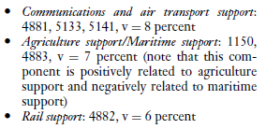
If this wider selection is taken, there are 6 different types
of T-KIBS location pattern (identified by principal component
analysis of location quotients)
- Design, software, R&D, management and scientific consultants,
computer system design, data processing, others
- mining support, architectural and engineering services

Slide 11
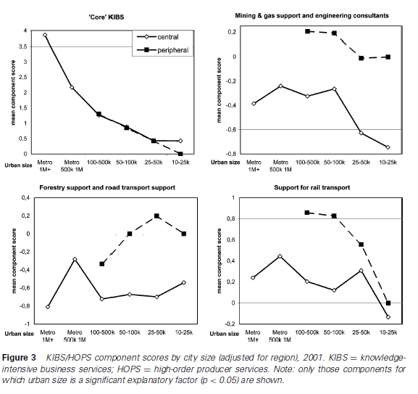
Four of which
vary significantly
across city-size
and urban-peripheral
dimensions.
Distance protection
effect is only evident
for some T-KIBS
sectors.

Slide 12
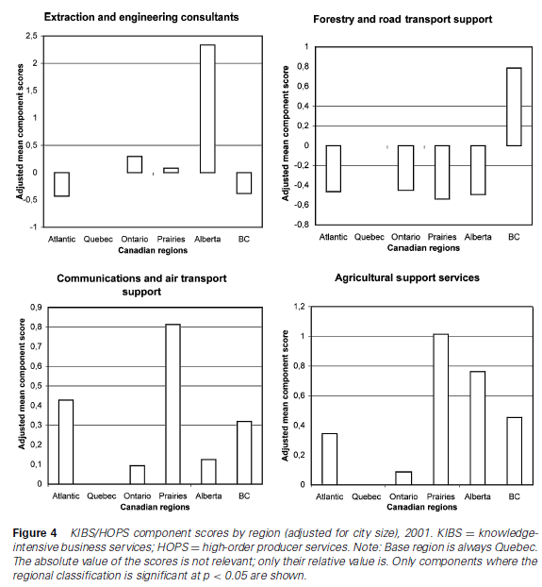
Four of which
vary significantly
across Canadian
regions
- extraction and engineering:
locates in same region as oil-fields
- forestry: highest in BC and Quebec, the
two strongest forestry regions.
- agricultural support: in the Prairies and
Alberta (wheat and cattle)
- communications and air transport support:
highest concentrations in remotest regions

Slide 13
So far, our results seem to establish that:
1- Some T-KIBS, particularly the ‘core’ ones, are strongly present in metropolitan
areas, but almost absent elsewhere.
2- Some KIBS are more strongly present in remote areas than in more central areas (distance protection? co-location with specific sectors?).
3- Some T-KIBS, often – but not exclusively – those more closely connected with a particular sector, seem to locate in the same part of Canada as that sector.
Next question:
Do T-KIBS co-locate (locate in same labour-market area) with particular sectors?

Slide 14
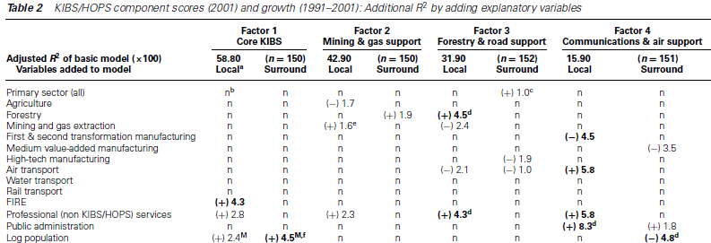
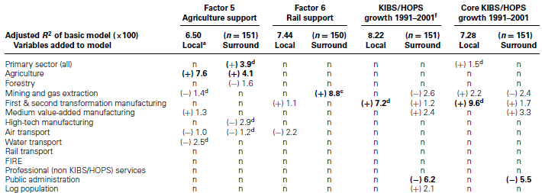

Slide 15
To sum up:
‘KIBS’ is a heterogenous group of activities and functions.
The ‘core’ group of KIBS locate almost exclusively in very large cities
More specialised KIBS (engineering consultants?) locate in regional centres.
Even more specific KIBS (whose activites may not be very knowledge intensive) seem to co-locate with client sectors.
BUT:
- if one assumes that KIBS, and particularly core KIBS, are important components of regional innovation systems.
- and if one allows for the fact that innovation occurs in many places across Canada
- one can deduce from these spatial patterns that different KIBS operate at different spatial scales.

Slide 16
In Canada
Outside world
Outside world
nation
local KIBS
local KIBS
Regional Scale
Interactions
only local interactions
National Scale Interactions
specialised KIBS
core-KIBS
local KIBS
Where is the regional innovation system?

Slide 17
Do cities benefit from having local KIBS?
So far we have looked at where KIBS locate (and have interpreted our findings on the assumption that they are important actors in innovation systems – although it appears that these systems operate across a variety of scales).
Now we turn to examining whether having high concentrations of local KIBS ‘benefits’ the local economy.
- we have no measure of city-wide innovation
- we examine common metrics of employment and income growth

Slide 18
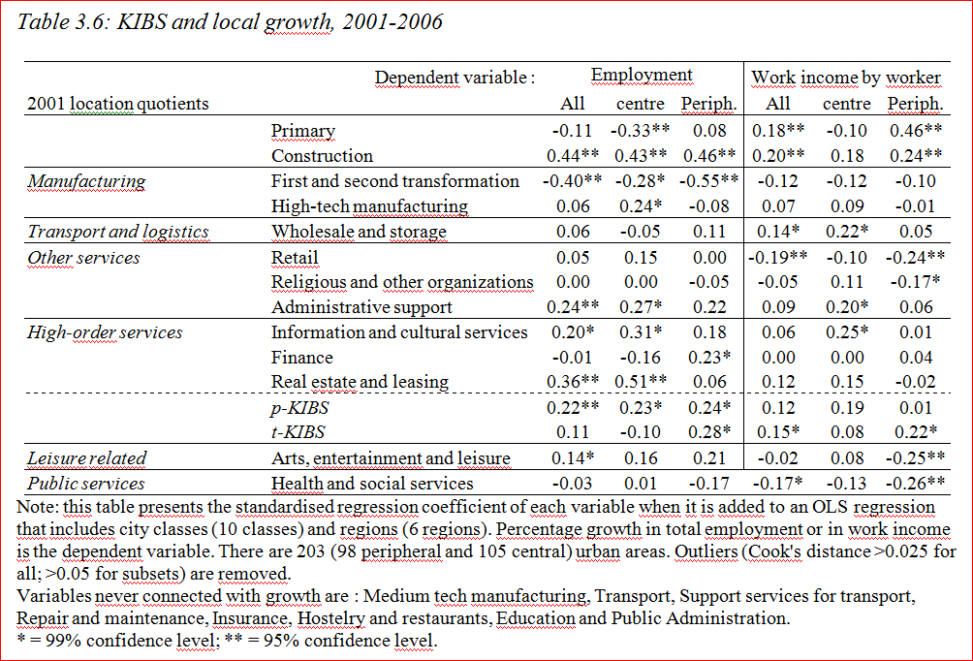
*
*
*
*
Only four sectors are associated with both employment and income growth
- of which T-KIBS in peripheral cities
This harks back to the distance protection effect and the higher presence of T-KIBS in these cities.

Slide 19
This suggests that:
Local T-KIBS may be associated with local innovation dynamics in isolated, peripheral cities .
Local T-KIBS are not associated with local innovation dynamics in central cities, that are close to metropolitan areas:
- shadow effect of metro areas?
- other growth dynamics at play (leisure? suburbanization?)

Slide 20
4- Where do we go from here?
All these results are suggestive of processes and scale effects.
They can be interpreted in a way that makes sense:
1- There are different types of KIBS: some act locally, some act across distance.
2- There are different types of locality: some are more dependent on local KIBS, others turn towards outside KIBS.
3- There are probably different types of KIBS user : some only look locally for KIBS, some look very widely.

Slide 21
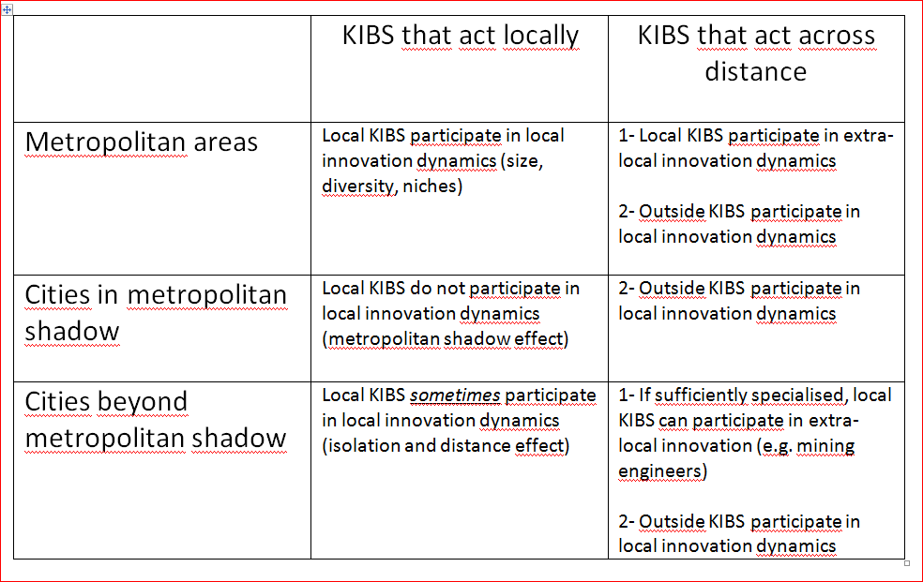
4- Where do we go from here?

Slide 22
4- Where do we go from here?
From a policy perspective:
- at least in Canada, the way in which KIBS interact with local economies is not very well understood. There is still work to be done...
However:
- it seems clear that all regions rely on input from KIBS outside the region (‘core’ T-KIBS, and probably high-end financial and management services).
- some regions (Metro areas and remote cities) develop their own specialised KIBS competencies.
- other regions almost uniquely on outside KIBS
Thus, local innovation policy should probably focus on ensuring that local establishments are able to identify and access appropriate KIBS, not on developing local KIBS capacity (except under certain circumstances)

Slide 23
4- Where do we go from here?
From a research perspective, David Doloreux and I have done research on the connection between locality, space, and KIBS innovation (not reported here).
- how does KIBS innovation vary across space?
- it does, but not as a function of local factors. It varies with distance from metro areas (Shearmur & Doloreux, 2009; Doloreux & Shearmur, 2010; Doloreux & Shearmur 2011)
We are now turning towards the way in which manufacturing clients in different locations use external services at different stages of the production process
- how does KIBS usage (and contribution to innovation) vary across space?

Slide 24
4- Where do we go from here?
Other questions that emerge from our research when KIBS, innovation and territory are considered:
- is the regional scale the right scale? How about intra-metropolitan neighbourhoods? Do apparently a-spatial networks have spatial structures? (Shearmur & Alvergne, 2002; Coffey & Shearmur, 2002)
- does it make sense to think in terms of spatialised / regional innovation systems? (Shearmur & Doloreux, 2009)
- what is KIBS innovation? what is innovation in a sector where the product is customised? (Shearmur & Doloreux, 2009; Doloreux & Shearmur, 2010)
- culture and KIBS services: can KIBS service operate globally? (Polèse & Shearmur, 2004)
- should we think in terms of KIBS sectors, or in terms of knowledge-intensive service functions (irrespective of sector)? (Shearmur, 2010).

Slide 25
Some references upon which this presentation is based
Doloreux, S. and R.Shearmur, 2011, Collaboration, Information and the Geography of Innovation in Knowledge Intensive Business Services, Journal of Economic Geography, forthcoming
Doloreux, D. M.Freel et R.Shearmur, 2010 (eds), Knowledge Intensive Business Services : Geography and Innovation, Farnham (UK) : Ashgate
*Shearmur, R., 2010, Scale, Distance and Embeddedness : Knowledge Intensive Business Service Location and Growth in Canada, in Doloreux, D. M.Freel et R.Shearmur, 2010 (eds)
Doloreux, D. et R.Shearmur, 2010, Exploring and comparing innovation patterns across different knowledge business services, Economics of Innovation and New Technology, on line http://www.informaworld.com/smpp/title~db=all~content=g919603578
Shearmur, R., et D.Doloreux, 2009, Place, Space and Distance: Towards a Geography of Knowledge Intensive Business Services Innovation, Industry and Innovation, 16.1, 79-102
*Shearmur, R. et D.Doloreux, 2008, Urban Hierarchy or Local Milieu? High-order Producer Service and (or) Knowledge-intensive Business Service Location in Canada, 1991-2001, Professional Geographer, 60.3, 333-355
Polèse, M. et R.Shearmur, 2004, ‘Culture, Language and the Location of High-Order Service Functions: the Case of Montreal and Toronto’, Economic Geography, 80.4, 329-350
Shearmur.R. et C.Alvergne, 2002, 'Intra-metropolitan Patterns of High-order Business Service Location: a Comparative Study of Seventeen Sectors in Ile-de-France', Urban Studies, 39.7, 1143-1164
Coffey.W. et R.Shearmur, 2002, 'Agglomeration and Dispersion of High-Order Service Employment in the Montreal Metropolitan Region, 1981-1996', Urban Studies, 39.3, 359-378
*Coffey.W et R.Shearmur, 1997, ‘The Growth and Location of High Order Services in the Canadian Urban System, 1971-1991’, The Professional Geographer, 49.4, 404-418
* = paper closely connected with topic discussed

